Slide 1
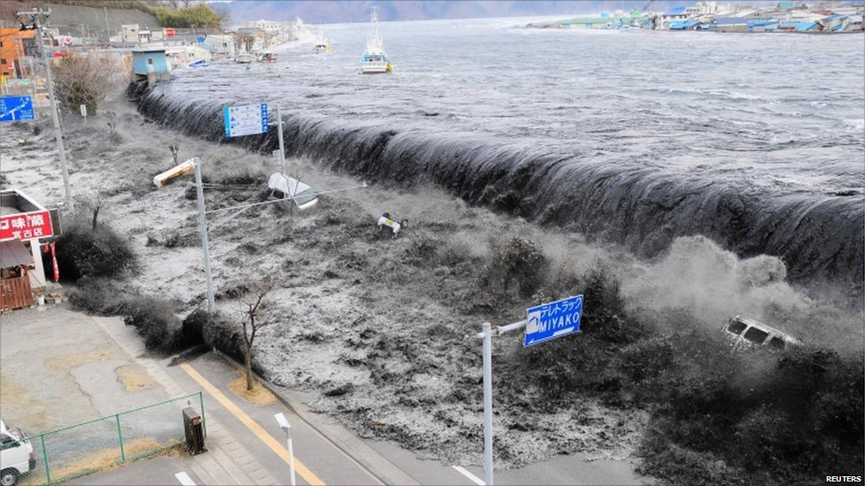
Bad things happen in three’s The Japanese earthquake, tsunami and nuclear crisis: March 2011
Notes:
Starter – clip and info
BBC clip http://www.youtube.com/watch?v=odMF4YhfZCc
http://www.bbc.co.uk/iplayer/episode/b00zxn24/BBC_News_Special_Japan_Special/

Slide 2
What: How would you allocate aid money after the Japanese Earthquake tsunami?
Why: To prioritize what needs to be done in a crisis
How: To work as a team to allocate the $25,000000 aid money and justify your choices

Slide 3
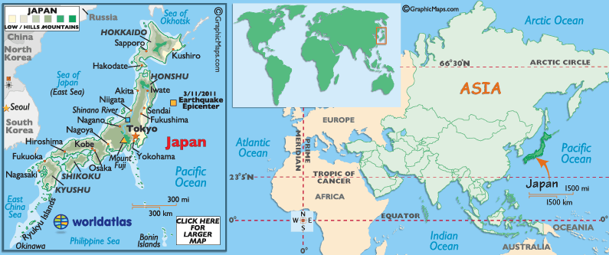
Bad things happen in three’s The Japanese earthquake, tsunami and growing nuclear crisis: March 2011
You are a crisis manager in the Sendai area of Japan in March 2011
Notes:
Success criteria on key words section of board: To make decisions about the response to events in Japan

Slide 4
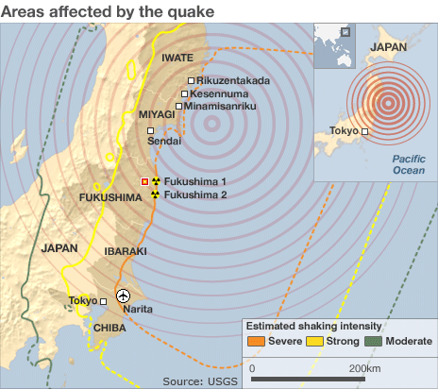
On 11th March 2011, Japan was struck by a massive earthquake 230 miles east of Tokyo.
Notes:
Intro - BBC interactive to recap - http://news.bbc.co.uk/1/hi/sci/tech/7533972.stm

Slide 5
This triggered a tsunami which spread 10km in land and devastated everything in its path.
Notes:
Intro - BBC interactive to recap - http://news.bbc.co.uk/1/hi/sci/tech/7533972.stm

Slide 6
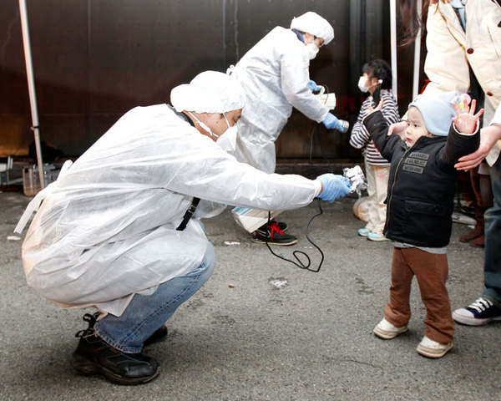
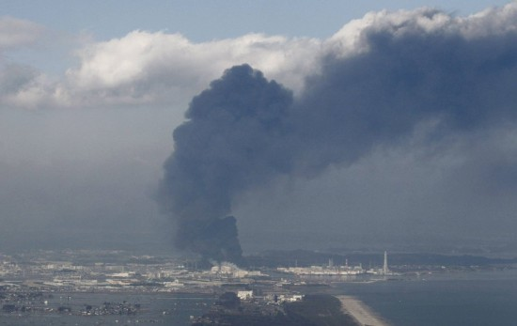
These events have caused many problems and explosions at nuclear power plants along the East coast which supply 30% of Japan’s electricity. There have been further explosions and harmful radiation leaks.
Notes:
Intro - BBC interactive to recap - http://news.bbc.co.uk/1/hi/sci/tech/7533972.stm

Slide 7
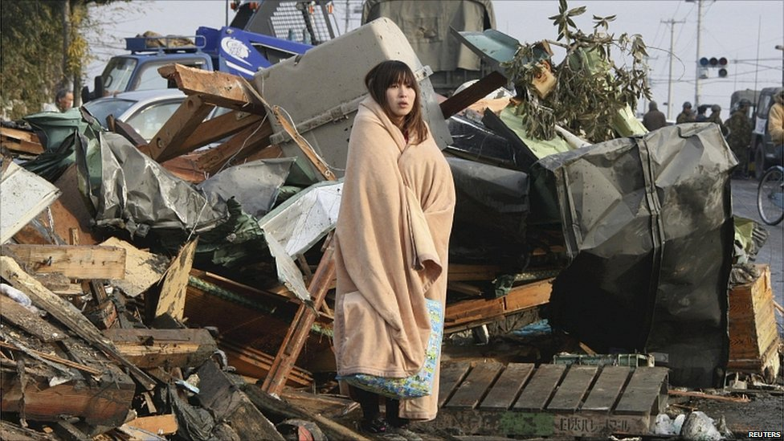
500,000 people are currently in emergency shelters
Notes:
Intro - BBC interactive to recap - http://news.bbc.co.uk/1/hi/sci/tech/7533972.stm

Slide 8
It is important that disaster relief teams and aid reaches the area ASAP to minimise the secondary effects of these events.
Tasks:
You work for the UNICEF emergency relief team. In your teams, you must decide what aid you will send to help the people of Japan.
You have a budget $25,000,000
You must complete the decision sheet to explain your choices
Notes:
Main 1 – DME 20 mins
Update http://www.bbc.co.uk/news/world-asia-pacific-12762759
http://uk.reuters.com/article/2011/03/18/uk-japan-quake-numbers-idUKTRE72H2A720110318
Slider photos
http://www.abc.net.au/news/events/japan-quake-2011/beforeafter.htm

Slide 9
Using your decision sheet, you must now prepare an action plan for the British Red Cross’ response to the events in Japan.
You must justify how you’ve spent the budget of $25 million
Your action plan will be assessed at the end using traffic lights, so use the criteria to help you.
Red (refused)
Amber (amend)
Green (approved)
Notes:
Main 2 – justify and write up 20 mins

Slide 10
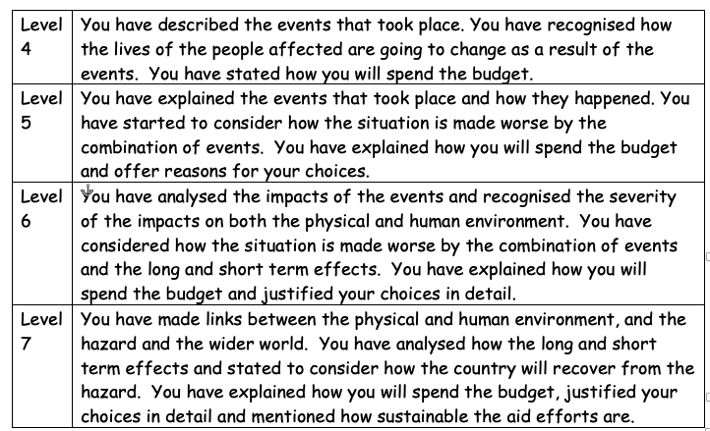
Success criteria for action plan write up

